Slide 1
Speed is key
How and why to use caching
Wie und warum caching verwenden
Notes:
But handling load most important Extra load = slower speed

Slide 2
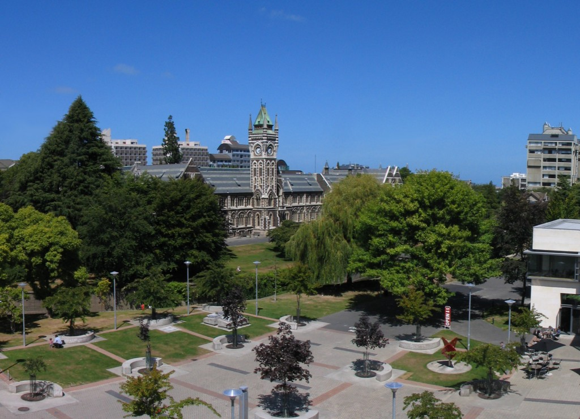
Land of the worlds crappiest internet!
Das Land mit der schlechtesten Internetverbindung

Slide 3
Notes:
1 TB data transfer/month = 10 million page views/month
$10/mnth
->
Managed VPS - no caching - seemed fine

Slide 4
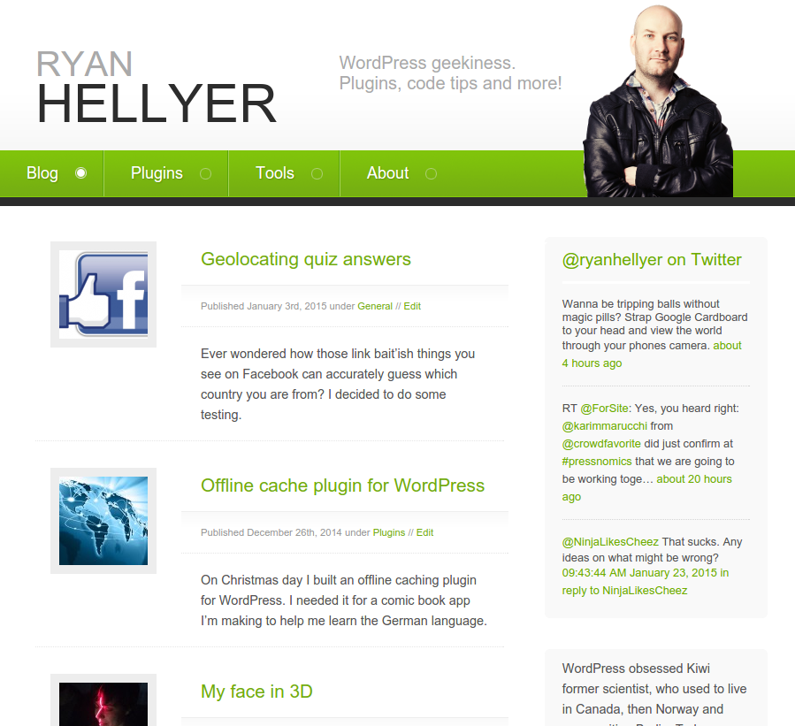

Slide 5
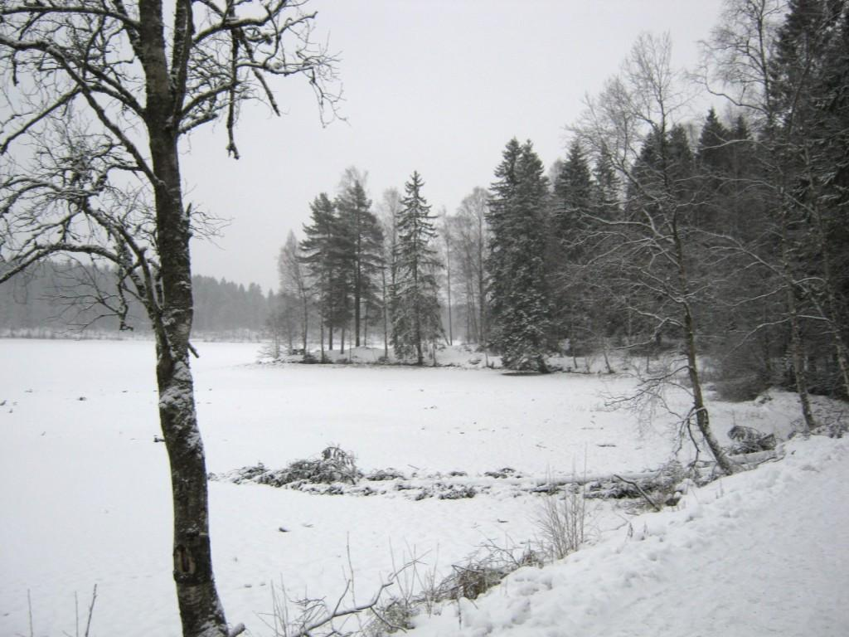
Move to Norway
Norway
Norwegen

Slide 6
Notes:
Realised lack of caching was a problem ~5 page views/sec via ApacheBench

Slide 7
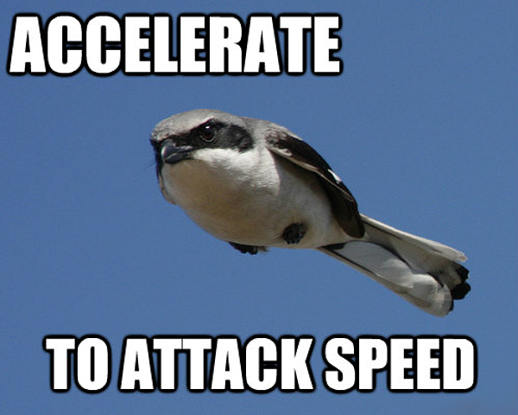

Slide 8
Static page caching
Statisches cachen von Internetseiten

Slide 9
Use faster software
Verwenden Sie schnellere Software
Nginx?
HHVM?

Slide 10
Notes:
Managed hosts
Static caching Needs more knowledge than most people realise

Slide 11
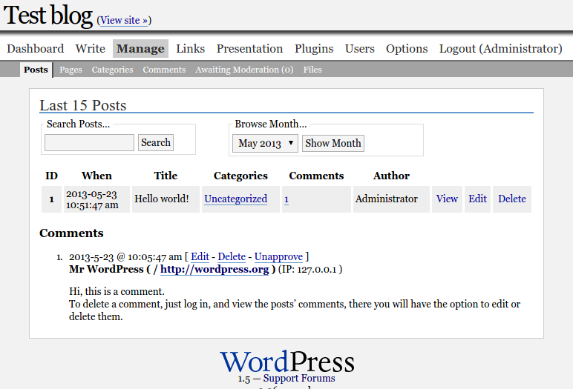
https://geek.hellyer.kiwi/tools/historic-wordpress/
Notes:
Make application do less
Work = time
Smaller app = faster app

Slide 12
~40,000 users in one day
40,000 benutzer im eins tag
Notes:
Less pages = easier to cache

Slide 13
Es gibt nur zwei schwierige Dinge in der Informatik, Namensgebung und zu entscheiden wann das Ablaufdatum einer Zwischenspeicherung erreicht ist.
- Phil Karlton

Slide 14
Persistent object caching Persistent-Objekt-Cachen
wp-content/object-cache.php
Database queries … ~20 -> ~4
Datenbankabfragen … ~20 -> ~4
May need theme customisation
Könnte Theme-Anpassungen benötige
Notes:
Discuss WP cache API

Slide 15
Object caching Objekt-Cachen
In memory cache
In Memory-Cache
Memcached
APC
Redis

Slide 18
Caching your bits
Cache dein Bits
Widgets
https://github.com/kasparsd/widget-output-cache
Fragment caching plugin
https://github.com/Rarst/fragment-cache
Menus
Menüs
https://geek.hellyer.kiwi/plugins/menu-cache/

Slide 19
Profiling Plugins
Find bad Plugins
Schlechte Plugins finden
https://github.com/Rarst/laps
https://wpperformanceprofiler.interconnectit.com/
Anti-spam
https://geek.hellyer.kiwi/plugins/spam-destroyer/

Slide 20
Page optimisation
Seitenoptimierung
Pingdom
Google Page Speed
Yahoo! YSlow
GT Metrix
These do not measure caching.
Diese müssen nicht Caching messen.

Slide 21
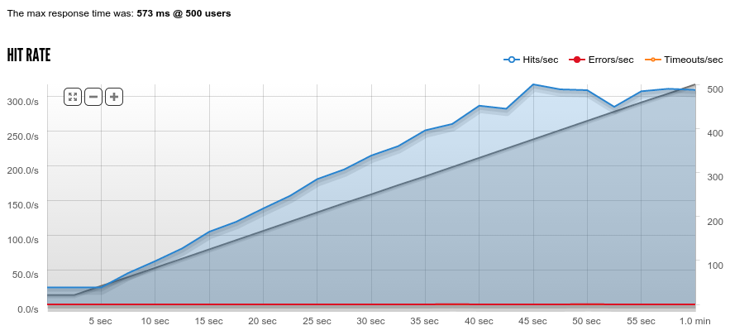
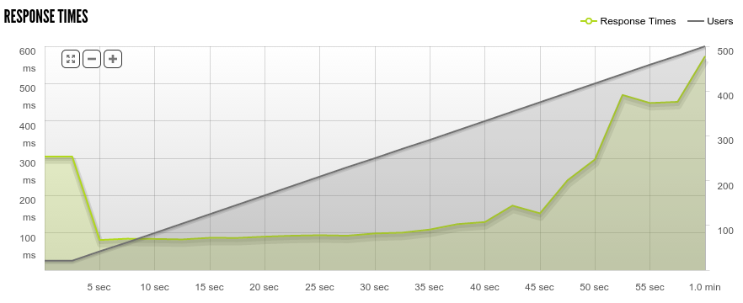
Measure Caching
Caching messen
Apache Bench
Siege
Blitz.io

Slide 22
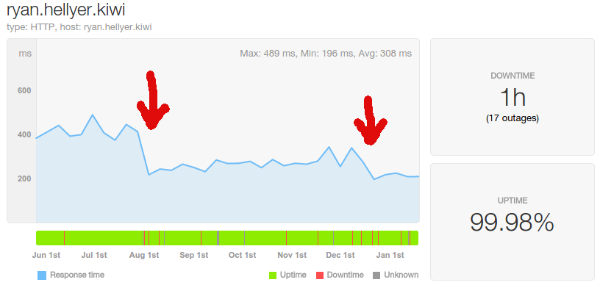
Notes:
1 = APC out of RAM 2 = Halved RAM. Added https. Used Nginx static cache and Redis. Swedish company. Outages due to stupidity.

Slide 23
Take home message …
Caching is hard
Cachen ist schwierig

Slide 24
https://geek.hellyer.kiwi/presentations/
@ryanhellyer

