Slide 1
Embedding Facebook

Slide 2
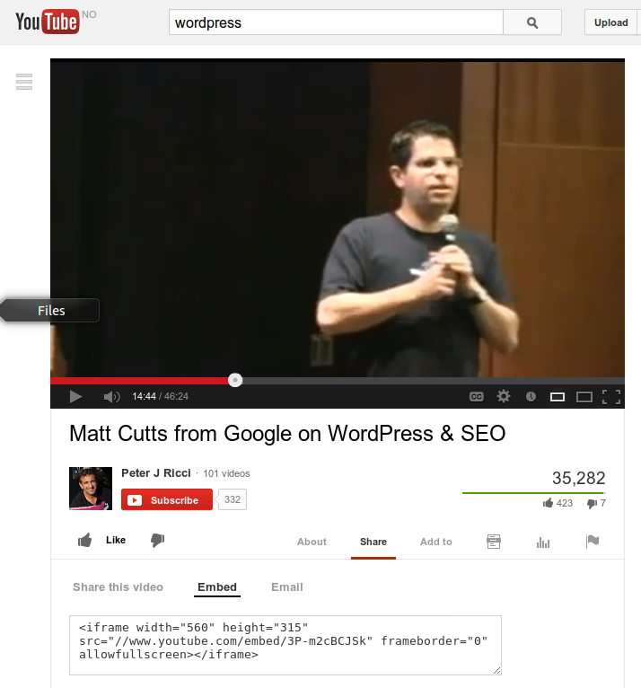
YouTube

Slide 3
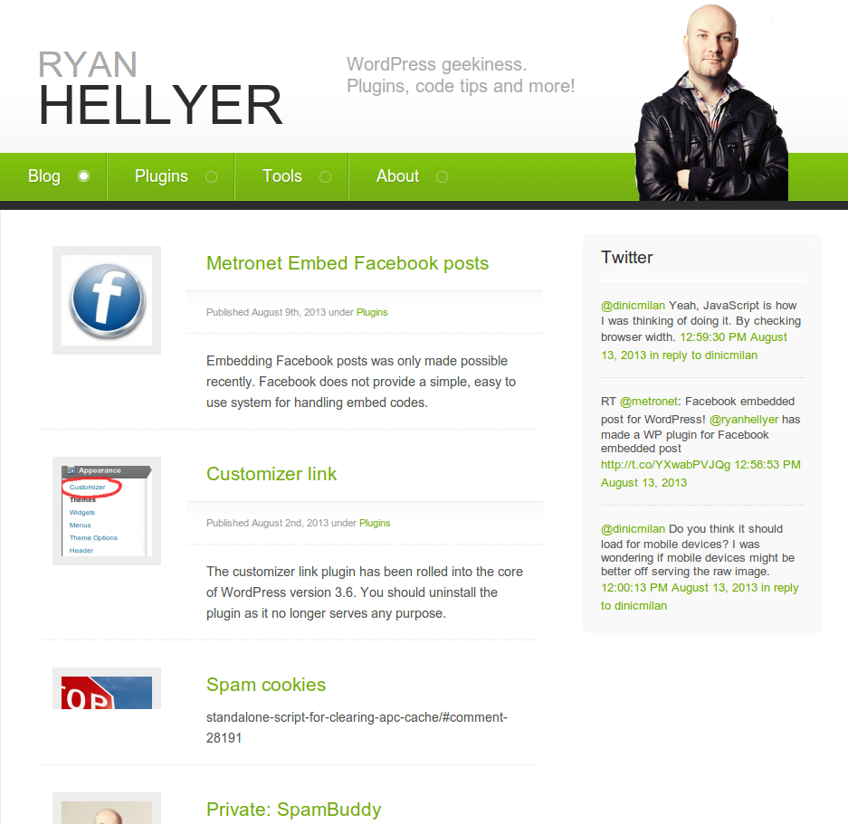
Twitter

Slide 4
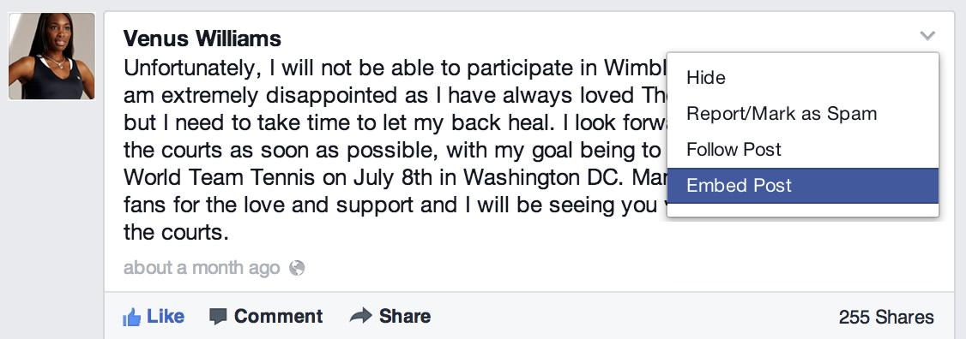
Facebook
Facebook application needed Button unneeded

Slide 5
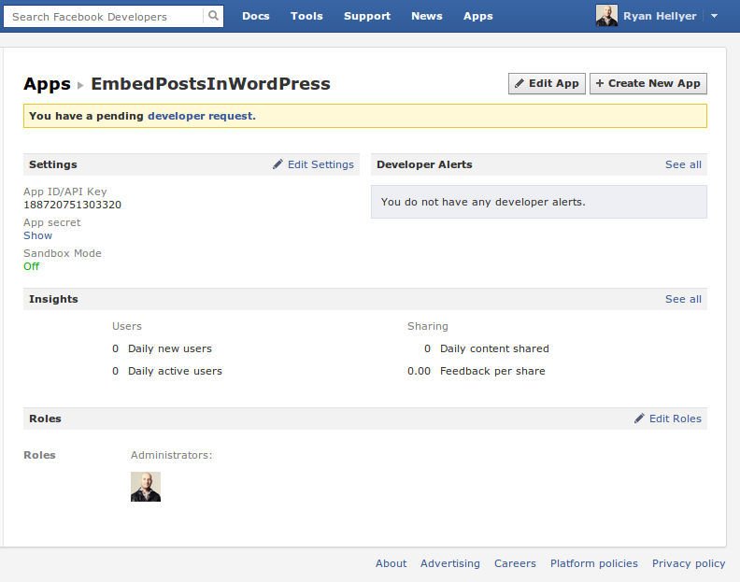
Facebook
application
Annoying
Complex
Time suck

Slide 6
Metronet Facebook Embed posts
The solution to all Facebook embed problems :)
demo time ….

Slide 7
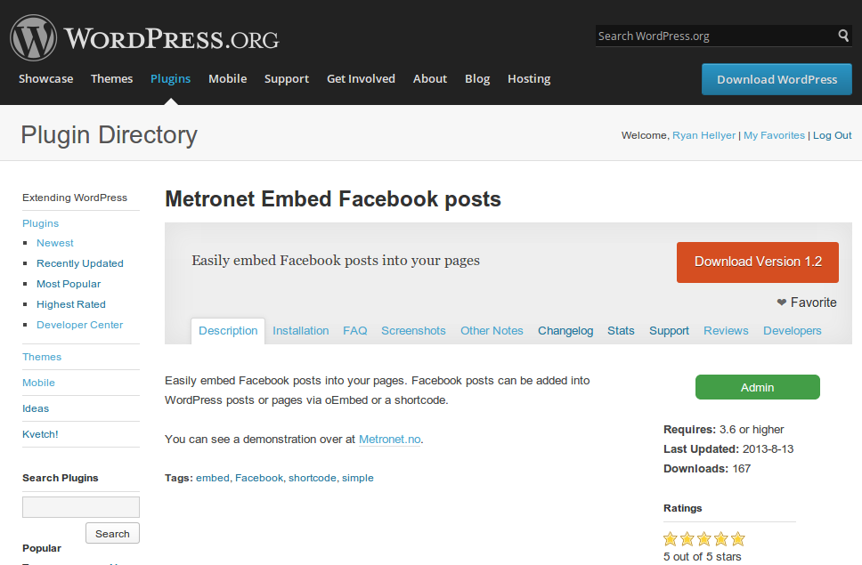
http://wordpress.org/plugins/metronet-embed-facebook-posts/

