Slide 1
“Decisions, not options”
- WordPress.org
http://geek.ryanhellyer.net/ http://twitter.com/ryanhellyer/

Slide 2
New Zealand

Slide 3
Norway
Winter

Slide 4
Norway
Summer

Slide 5
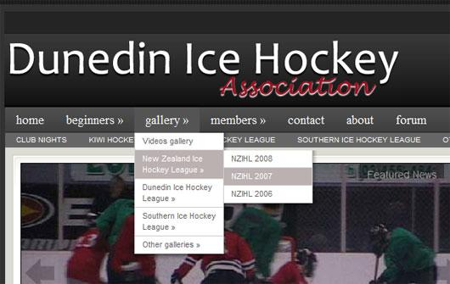
Menu plugins
http://geek.ryanhellyer.net/ http://twitter.com/ryanhellyer/

Slide 8
Simple Colorbox
“Okay, this sounds really lame, but after activating Simple Colorbox I cannot find the settings page. Nothing appears anywhere on my WP dashboard or on the plugin page. Help please.”
http://geek.ryanhellyer.net/ http://twitter.com/ryanhellyer/

Slide 9
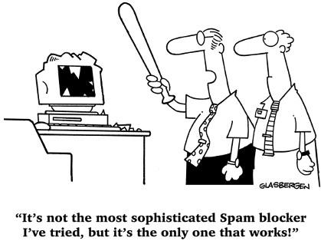
Spam Destroyer

Slide 10
wp-config.php constants

Slide 11
Self-learning WordPress

Slide 12
Examples
Server side
Learns from spam statistics
http://geek.ryanhellyer.net/ http://twitter.com/ryanhellyer/

Slide 15
Simple Colorbox
Users want to change design
No way to know design
http://geek.ryanhellyer.net/ http://twitter.com/ryanhellyer/

Slide 16
New Spam Destroyer
Not server-side like Akismet
Users need to adjust spam protection
Tracks stats and adjust protection accordingly
http://geek.ryanhellyer.net/ http://twitter.com/ryanhellyer/

Slide 17
Language learning

Slide 18
Nuts and bolts
User login
Answer questions
Calculate difficulty
Calculate user skill
http://geek.ryanhellyer.net/ http://twitter.com/ryanhellyer/

Slide 19
http://geek.ryanhellyer.net/ http://twitter.com/ryanhellyer/

Slide 21
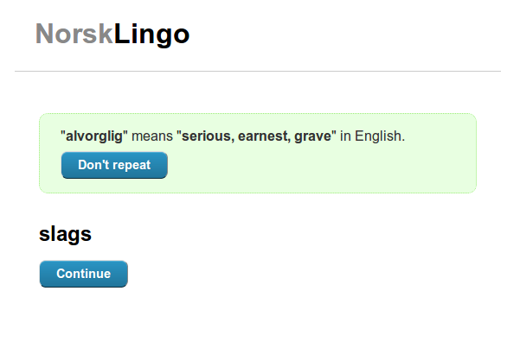
Demo time ...
http://geek.ryanhellyer.net/ http://twitter.com/ryanhellyer/

Slide 22
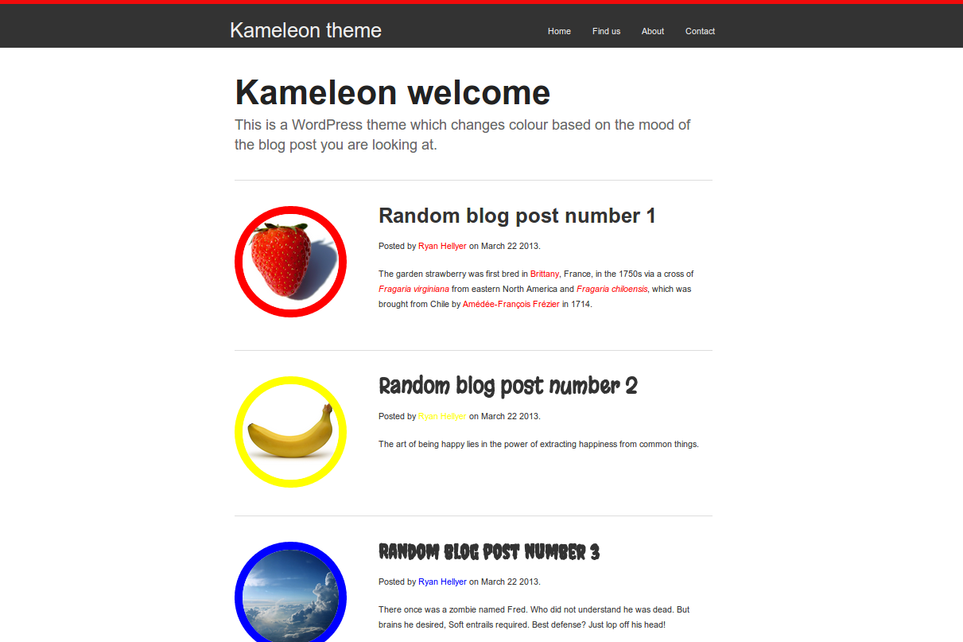
Self-learning design demo
http://geek.ryanhellyer.net/ http://twitter.com/ryanhellyer/

Slide 23
The future
conclusion
Options, without decisions

Slide 24
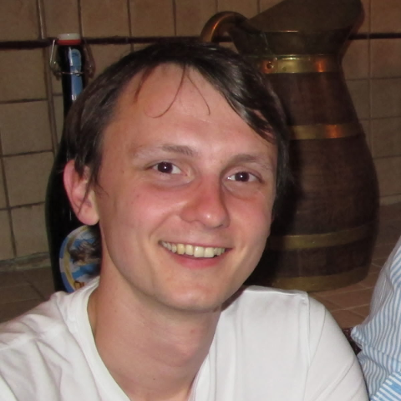
Thanks to ...
Kaspars Dambis Ronald Huereca

Slide 25
WordPress geek blog
http://geek.ryanhellyer.net/
Personal blog
http://ryanhellyer.net/
Twitter
http://twitter.com/ryanhellyer/

